Slide 1

APEX INSTITUTE OF TECHNOLOGY
DEPARTMENT OF COMPUTER SCIENCE & ENGINEERING
Artificial Intelligence (20CSD-385)
Faculty: Ankur Sharma(E13693)
Lecture – 2.1
FOPL
DISCOVER . LEARN . EMPOWER

Slide 2
Artificial Intelligence : Course Objectives
COURSE OBJECTIVES
(AI) is a research field that studies how to realize the intelligent human behaviors on a computer. The ultimate goal of AI is to make a computer that can learn, plan, and solve problems autonomously. Although AI has been studied for more than half a century, we still cannot make a computer that is as intelligent as a human in all aspects, The main research topics in AI include: problem solving, reasoning, planning, natural language understanding, computer vision, automatic programming, machine learning, and so on. Of course, these topics are closely related with each other. In this course, we will study the most fundamental knowledge for understanding AI. We will introduce some basic search algorithms for problem solving; knowledge representation and reasoning; pattern recognition; fuzzy logic; and neural networks

Slide 3
COURSE OUTCOMES
On completion of this course, the students shall be able to:-
CO3 | Design and Analyse search algorithms on well formulated problems.
CO4 | Evaluate the problem using Propositional and First order logic.

Slide 4
Unit-2 Syllabus
Unit-2 |  | Contact Hours:15 hours
Ch1. FOPL & Knowledge representation | First order logic. Inference in first order logic, propositional vs. first order inference, unification & lifts forward chaining, Backward chaining, Resolution,
Ch2. REASONING Programming: | Reasoning under uncertainty, review of probability, Bayes’ Logic probabilistic interferences and dempster Shafer theory.
Ch 3. Knowledge representation | Knowledge representation issues, predicate logic- logic programming, semantic nets- frames and inheritance, constraint propagation, representing knowledge using rules, rules-based deduction systems.

Slide 5
SUGGESTIVE READINGS
TEXT BOOKS
T1. Artificial Intelligence: A Modern Approach by Stuart Russell and Peter Norvig. Prentice-Hall, 2003 (2ndEdition). T2. Elaine Riche, Kevin Knight and Shivashankar B. Nair, “Artificial Intelligence”, Third Edition, TMH Educations Pvt. Ltd., 2008
REFERENCE BOOKS
R1 Nils J. Nilsson, “The Quest for Artificial Intelligence”, Second Edition, Cambridge University Press, 2009
R2 Artificial Intelligence and Expert Systems – Dan W. Patterson, Prentice Hall of India

Slide 6
FOPL & Knowledge representation
First order logic, Inference in first order logic, propositional vs. first order inference, unification & lifts forward chaining, Backward chaining, Resolution,

Slide 7
Beyond Propositional logic
• Propositional logic not expressive enough
– In Wumpus world we needed to explicitly write every
case of Breeze & Pit relation
– Facts = propositions
– “All squares next to pits are breezy”
• “Regular” programming languages mix facts
(data) and procedures (algorithms)
– World[2,2]=Pit
– Cannot deduce/compose facts automatically
– Declarative vs. Procedural

Slide 8
Natural Language
• Natural language probably not used for
representation
– Used for communication
– “Look!

Slide 9
First-Order Logic
Idea:
– Don’t treat propositions as “atomic” entities.
• First-Order Logic:
– Objects: cs4701, fred, ph219, emptylist …
– Relations/Predicates: is_Man(fred), Located(cs4701,
ph219), is_kind_of(apple, fruit)…
• Note: Relations typically correspond to verbs
– Functions: Best_friend(), beginning_of() : Returns object(s)
– Connectives: , , ➢, , 
– Quantifiers:
• Universal: x: ( is_Man(x) ) is_Mortal(x) )
• Existential: y: ( is_Father(y, fred) )
Predicates
• In traditional grammar, a predicate is one of the two main parts of a sentence the other being the subject, which the predicate modifies.
• "John is yellow" John acts as the subject, and is yellow acts as the predicate.
• The predicate is much like a verb phrase.
• In linguistic semantics a predicate is an expression that can be true of something

Slide 10
Types of formal mathematical logic
• Propositional logic
– Propositions are interpreted as true or false
– Infer truth of new propositions
• First order logic
– Contains predicates, quantifiers and variables
E.g. Philosopher(a) → Scholar(a)
x, King(x)  Greedy (x)  Evil (x)
– Variables range over individuals (domain of discourse)
• Second order logic
– Quantify over predicates and over sets of variables
Temporal logic
• Truths and relationships change and depend on time
• Fuzzy logic
– Uncertainty, contradictions

Slide 11
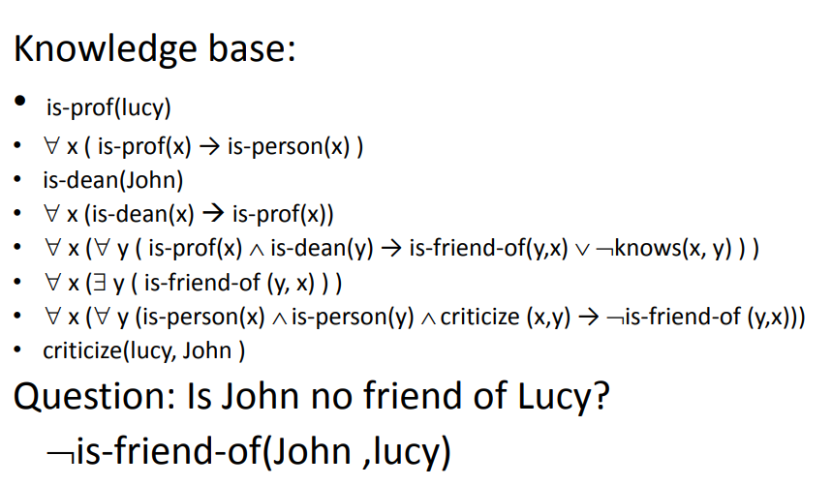
Example:
Representing Facts in First-Order Logic
1. Lucy* is a professor
2. All professors are people.
3. John is the dean.
4. Deans are professors.
5. All professors consider the dean a friend or don’t know him.
6. Everyone is a friend of someone.
7. People only criticize people that are not their friends.
8. Lucy criticized John

Slide 12
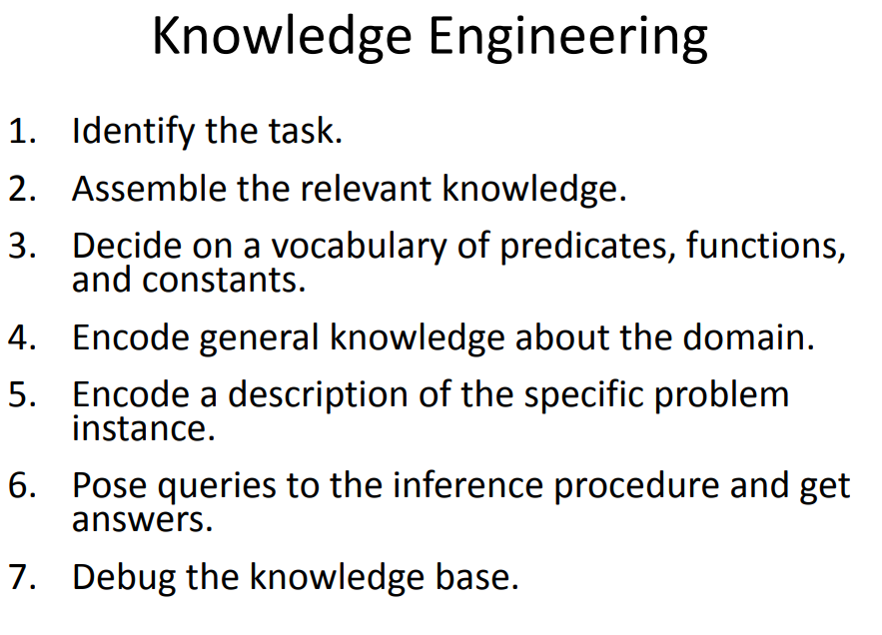
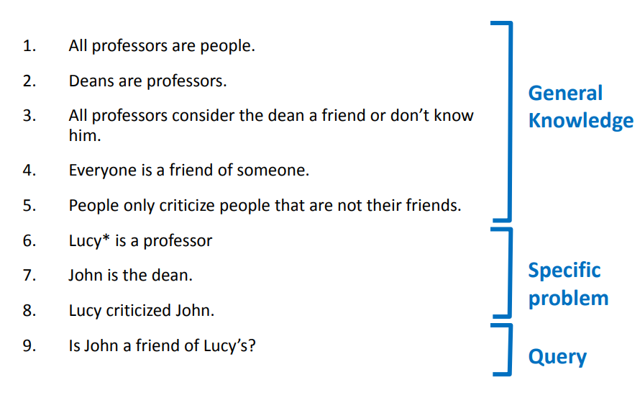

Slide 13
REFERENCES
Artificial Intelligence: A Modern Approach by Stuart Russell and Peter Norvig. Prentice-Hall, 2003 (2nd Edition).

Slide 14
THANK YOU
For queries
Email: Ankur.e13693@cumail.in

